Slide 1
Retail Sales Intelligence Pipeline
Transforming Raw Transactional Data into Actionable Business Intelligence
Presented by
Nehasri M

Slide 2
Problem Statement
Retail businesses need to track sales performance and understand customer behavior.
Identifying growth opportunities, high-value customers, and buying patterns can be challenging.
Businesses also need to monitor inventory and product performance.
This project develops an end-to-end analytics solution to generate insights from raw transactional data using multiple data analytics tools.
Objective:
To transform raw retail transactional data into meaningful business insights for better analysis and management.

Slide 3
Technical Architecture & Execution Pipeline
Data Processing Framework
Tool | Role | Key Tasks Completed
Excel | Data Cleaning & Preparation | Cleaned data, handled missing values & duplicates, created Total_Price, prepared CSV files
SQL | Data Storage & Analysis | Created relational tables, imported data, performed JOINs, sales/customer/staff analysis, stock alerts
Python | Data Analysis & Segmentation | Performed EDA, calculated RFM, analyzed customer behavior, performed customer segmentation
Power BI | Visualization & Reporting | Built data model, KPIs, sales/product/customer analysis, inventory & staff visuals, interactive dashboard

Slide 4
Database Architecture & Operational Warehousing
Relational Schema & Warehousing Execution
Core Business Discoveries & Rules
Database Infrastructure: Initialized the centralized retail relational schema, deploying 9 mapped data tables (including brands, categories, customers, and products).
Data Lake Ingestion: Loaded the cleaned master tables into SQL using native table import routines, securing structural integrity.
Relational Unified View: Programmed a multi-table internal JOIN sequence binding order logs, transaction items, and inventory attributes into an active sales overview.
Revenue Mapping: Grouped total net sales values dynamically across active storefront allocations (Store _id).
Velocity Tracking: Isolated the top 5 highest-selling products by quantity using sorting limits.
Proactive Stock Alerts: Flagged all products with low store inventory levels (Stock < 10 units) to prevent out-of-stock events
Automated Budget Brackets: Coded conditional server rules to rank customers into three spending tiers based on historical lifetime revenue: Low Spend: Up to $10,000, Medium Spend: $10,001 to $35,000, High Spend: Over $35,000.
Data Warehouse Target: Constructed a primary-keyed customer_ segments repository table to store future customer metrics

Slide 5
Exploratory Data Analysis & Feature Engineering
Live Ingestion: Established programmatic bridges using engine connectors to read production backend tables directly into Pandas DataFrames.
Structural Diagnosis: Ran descriptive summary statistics (.describe(), .info()) and Matplotlib/Seaborn plots to evaluate target metrics.
Behavior Behavioral Profiling (RFM): Modeled core customer activity metrics:
  Recency: Calculated exact days elapsed since a customer's last purchase transaction.
  Frequency: Counted cumulative distinct order instances per buyer.
  Monetary: Summarized total financial wallet share captured per buyer profile.
Database Feedback: Programmatically synced calculated user segmentation categories back into the operational database environment.

Slide 6
The Executive Review
🔗Live Interactive Dashboard -
WHAT WE BUILT | KEY BUSINESS INSIGHTS
Executive KPIs — $8.58M Revenue • $5.31K AOV • 1615K Orders • 1K Active Customers | New York (NY): Highest sales share (68%)
2-Page Dashboard — Sales Overview + Operations & Customer Action Center | CA & TX: Secondary markets (21% and 11%)
Geographic Analysis — Regional sales performance | Top Sales Reps: Marcelene Boyer & Venita Daniel (~$2.9M each)
Employee Performance — Revenue contribution by staff | 323 Low-Stock Lines: Product-store stock below 10 units (221 products)
Inventory Risk Monitor — Critical-stock alerts | Electra Cruiser: 20 of 57 store-level stock lines below 10 units

Slide 7
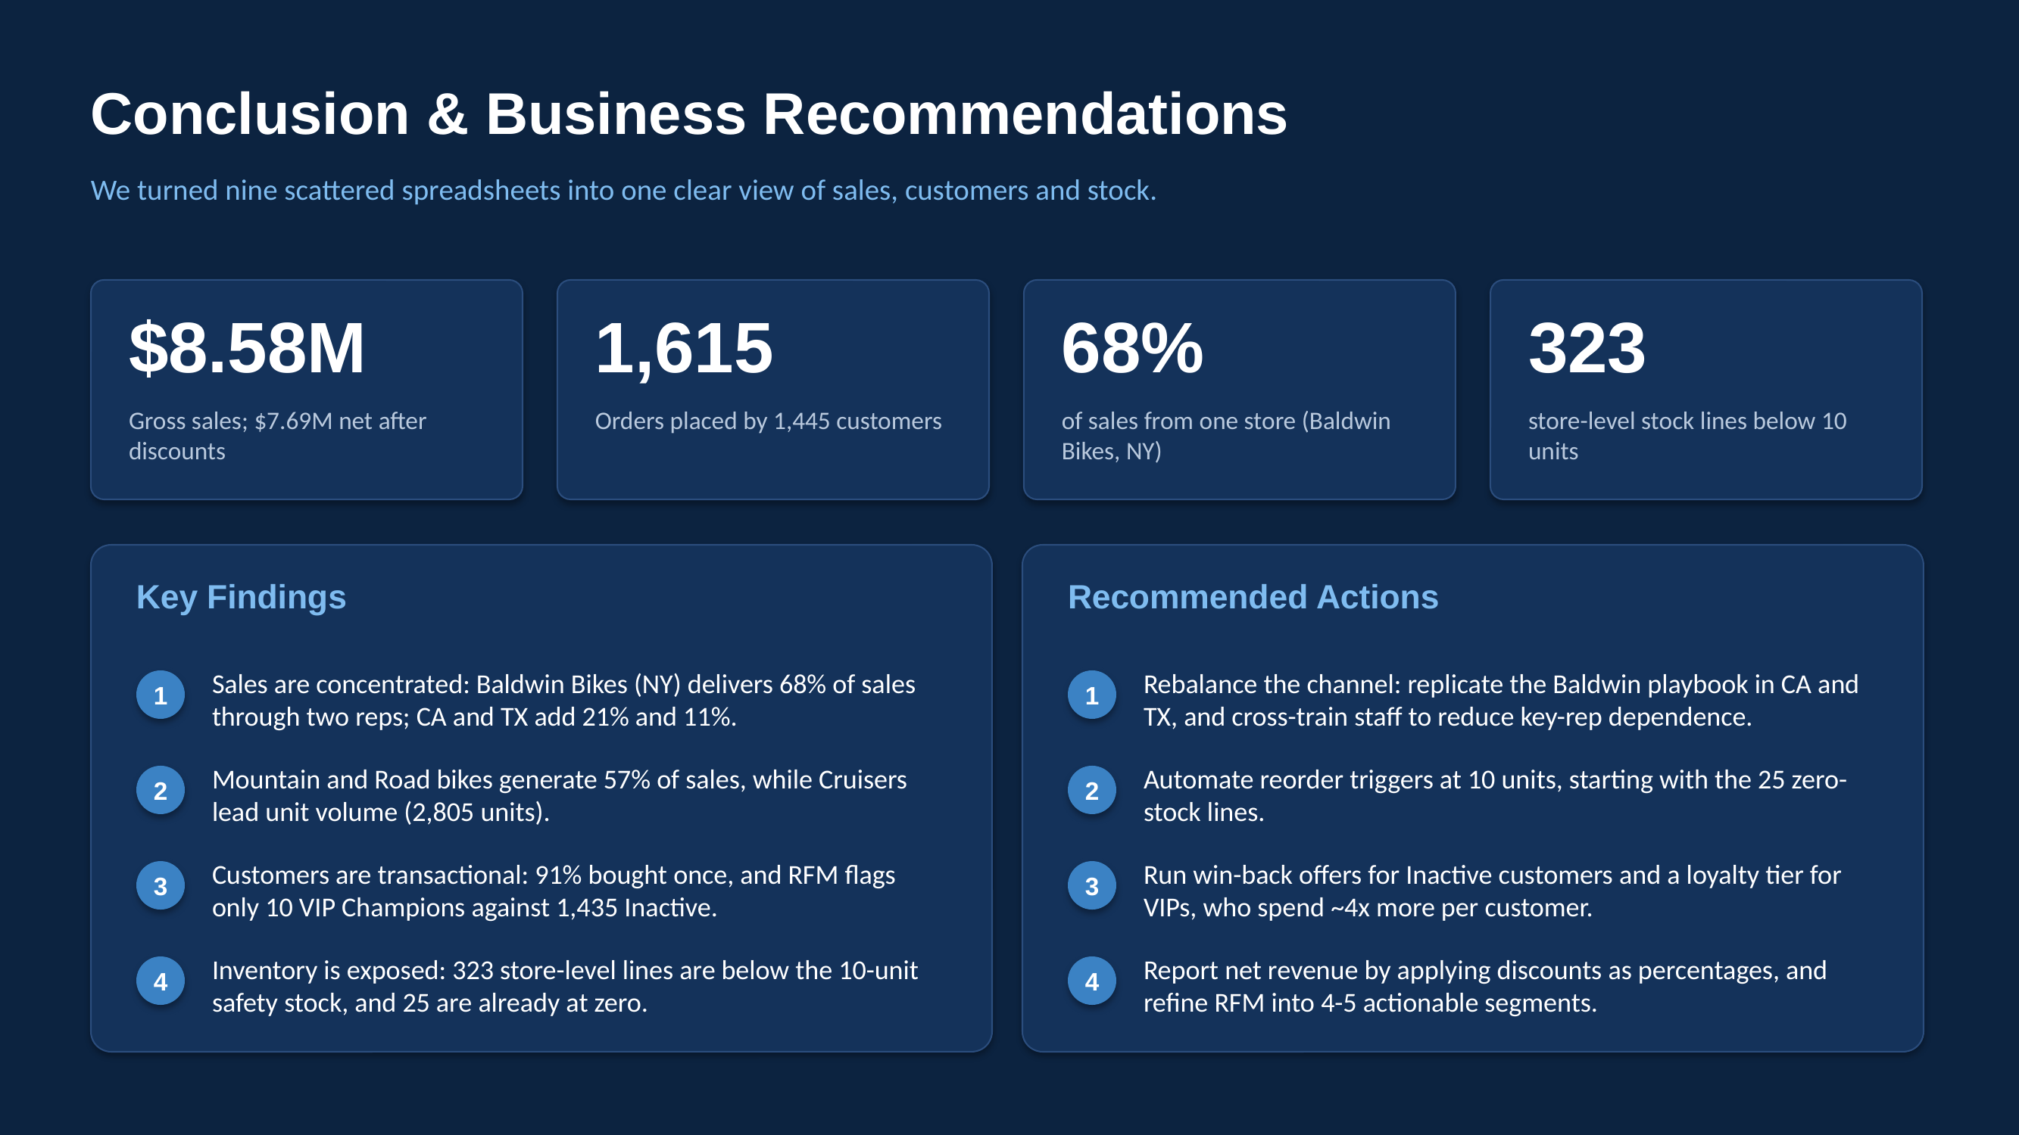
Thank you

